Slide 1
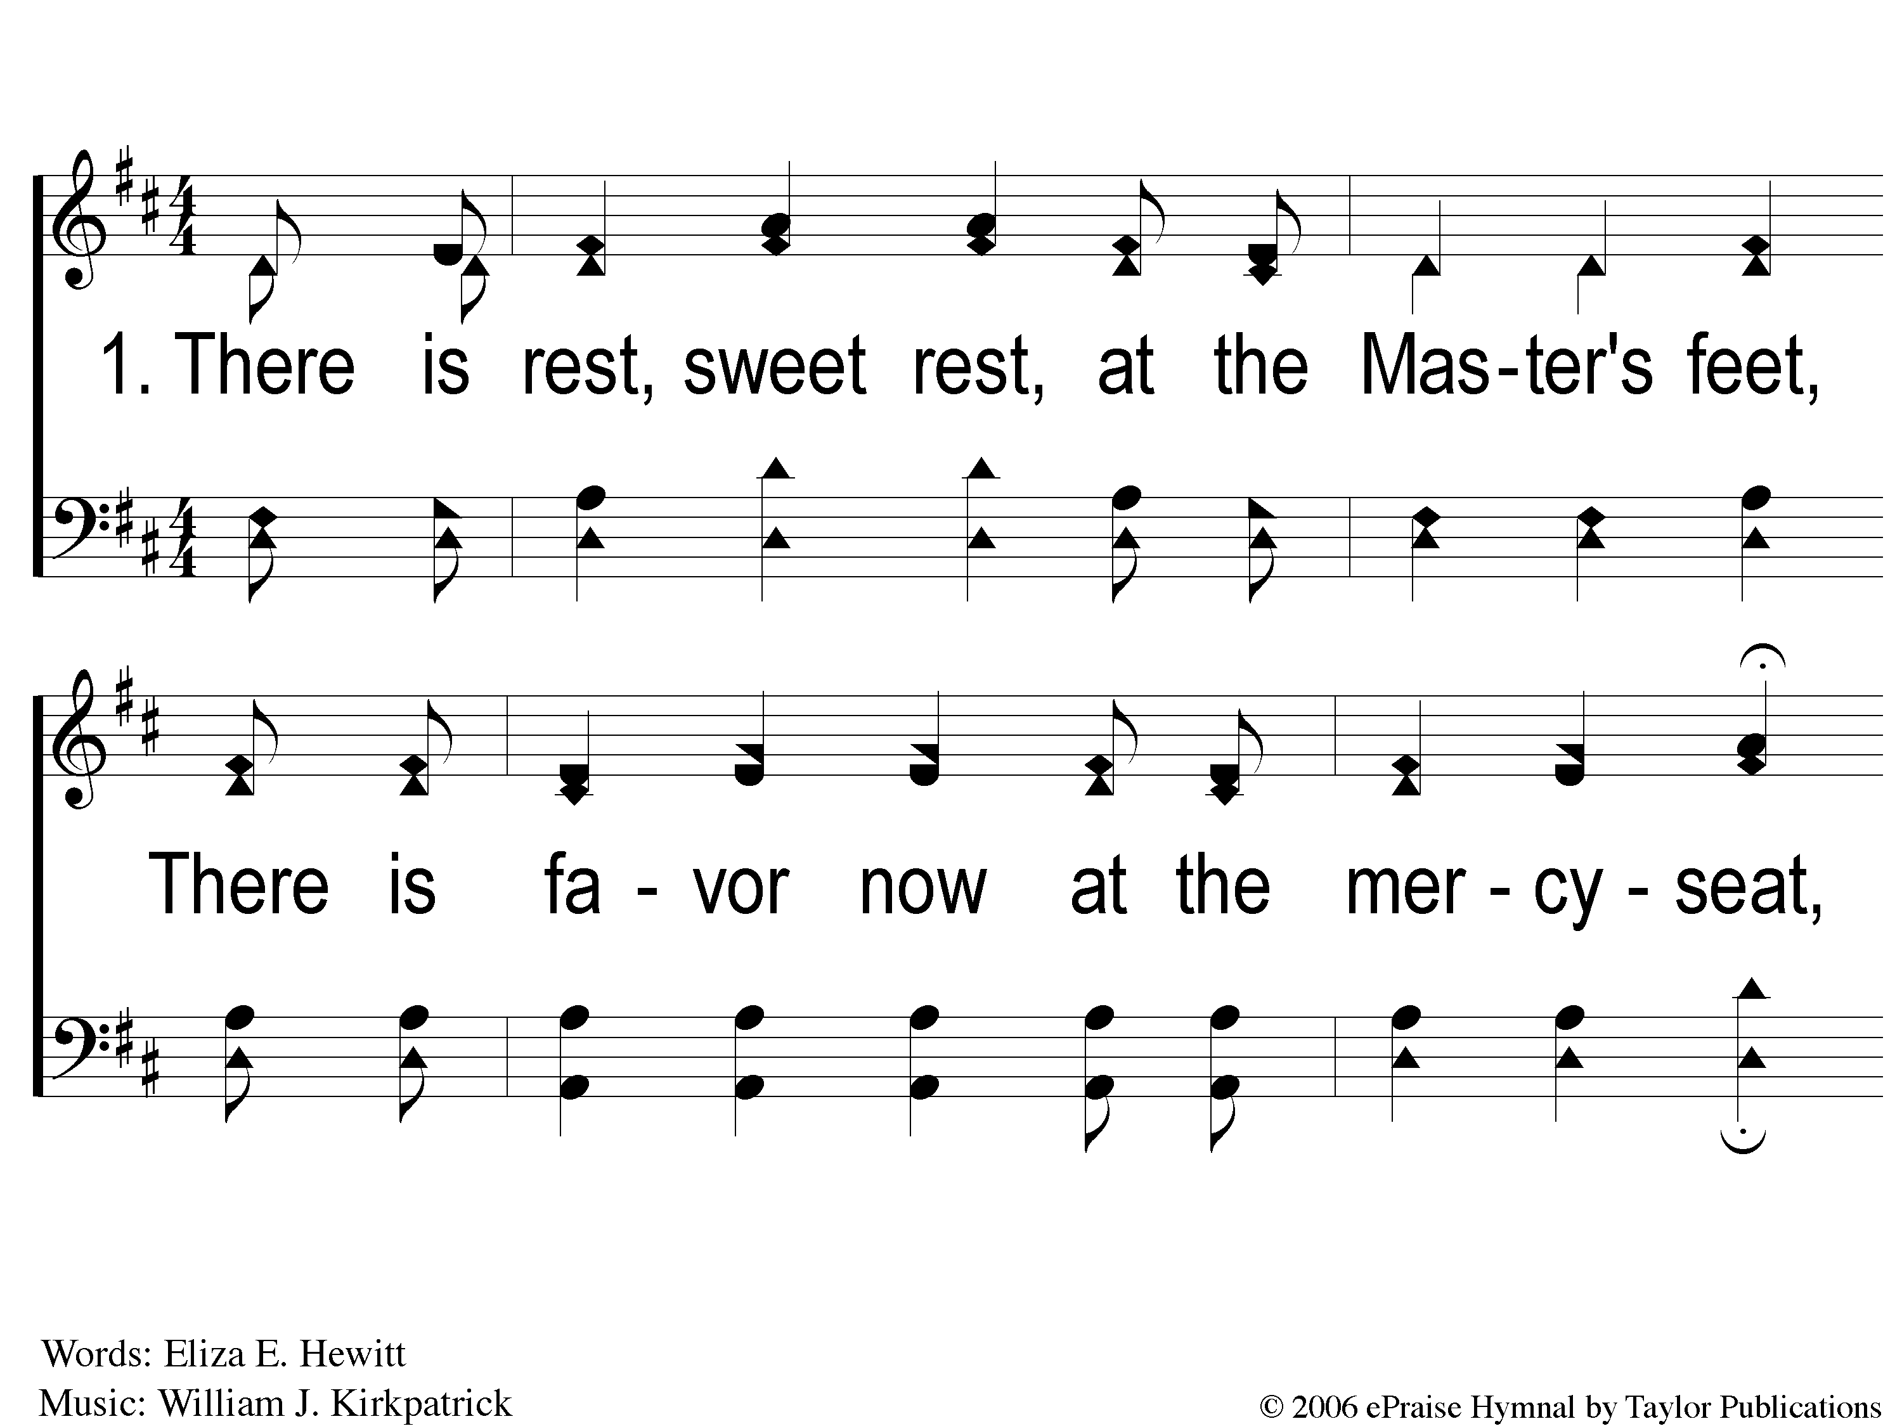
1-1 A Blessing in Prayer
A Blessing In Prayer
13

Slide 2
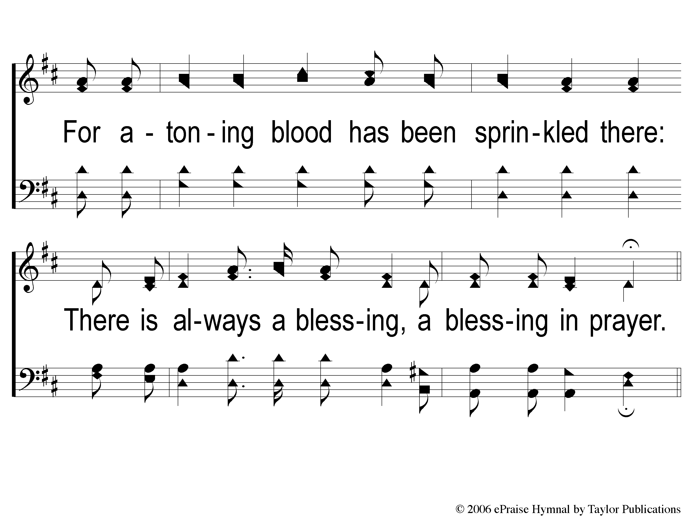
1-2 A Blessing in Prayer
A Blessing In Prayer
13

Slide 3
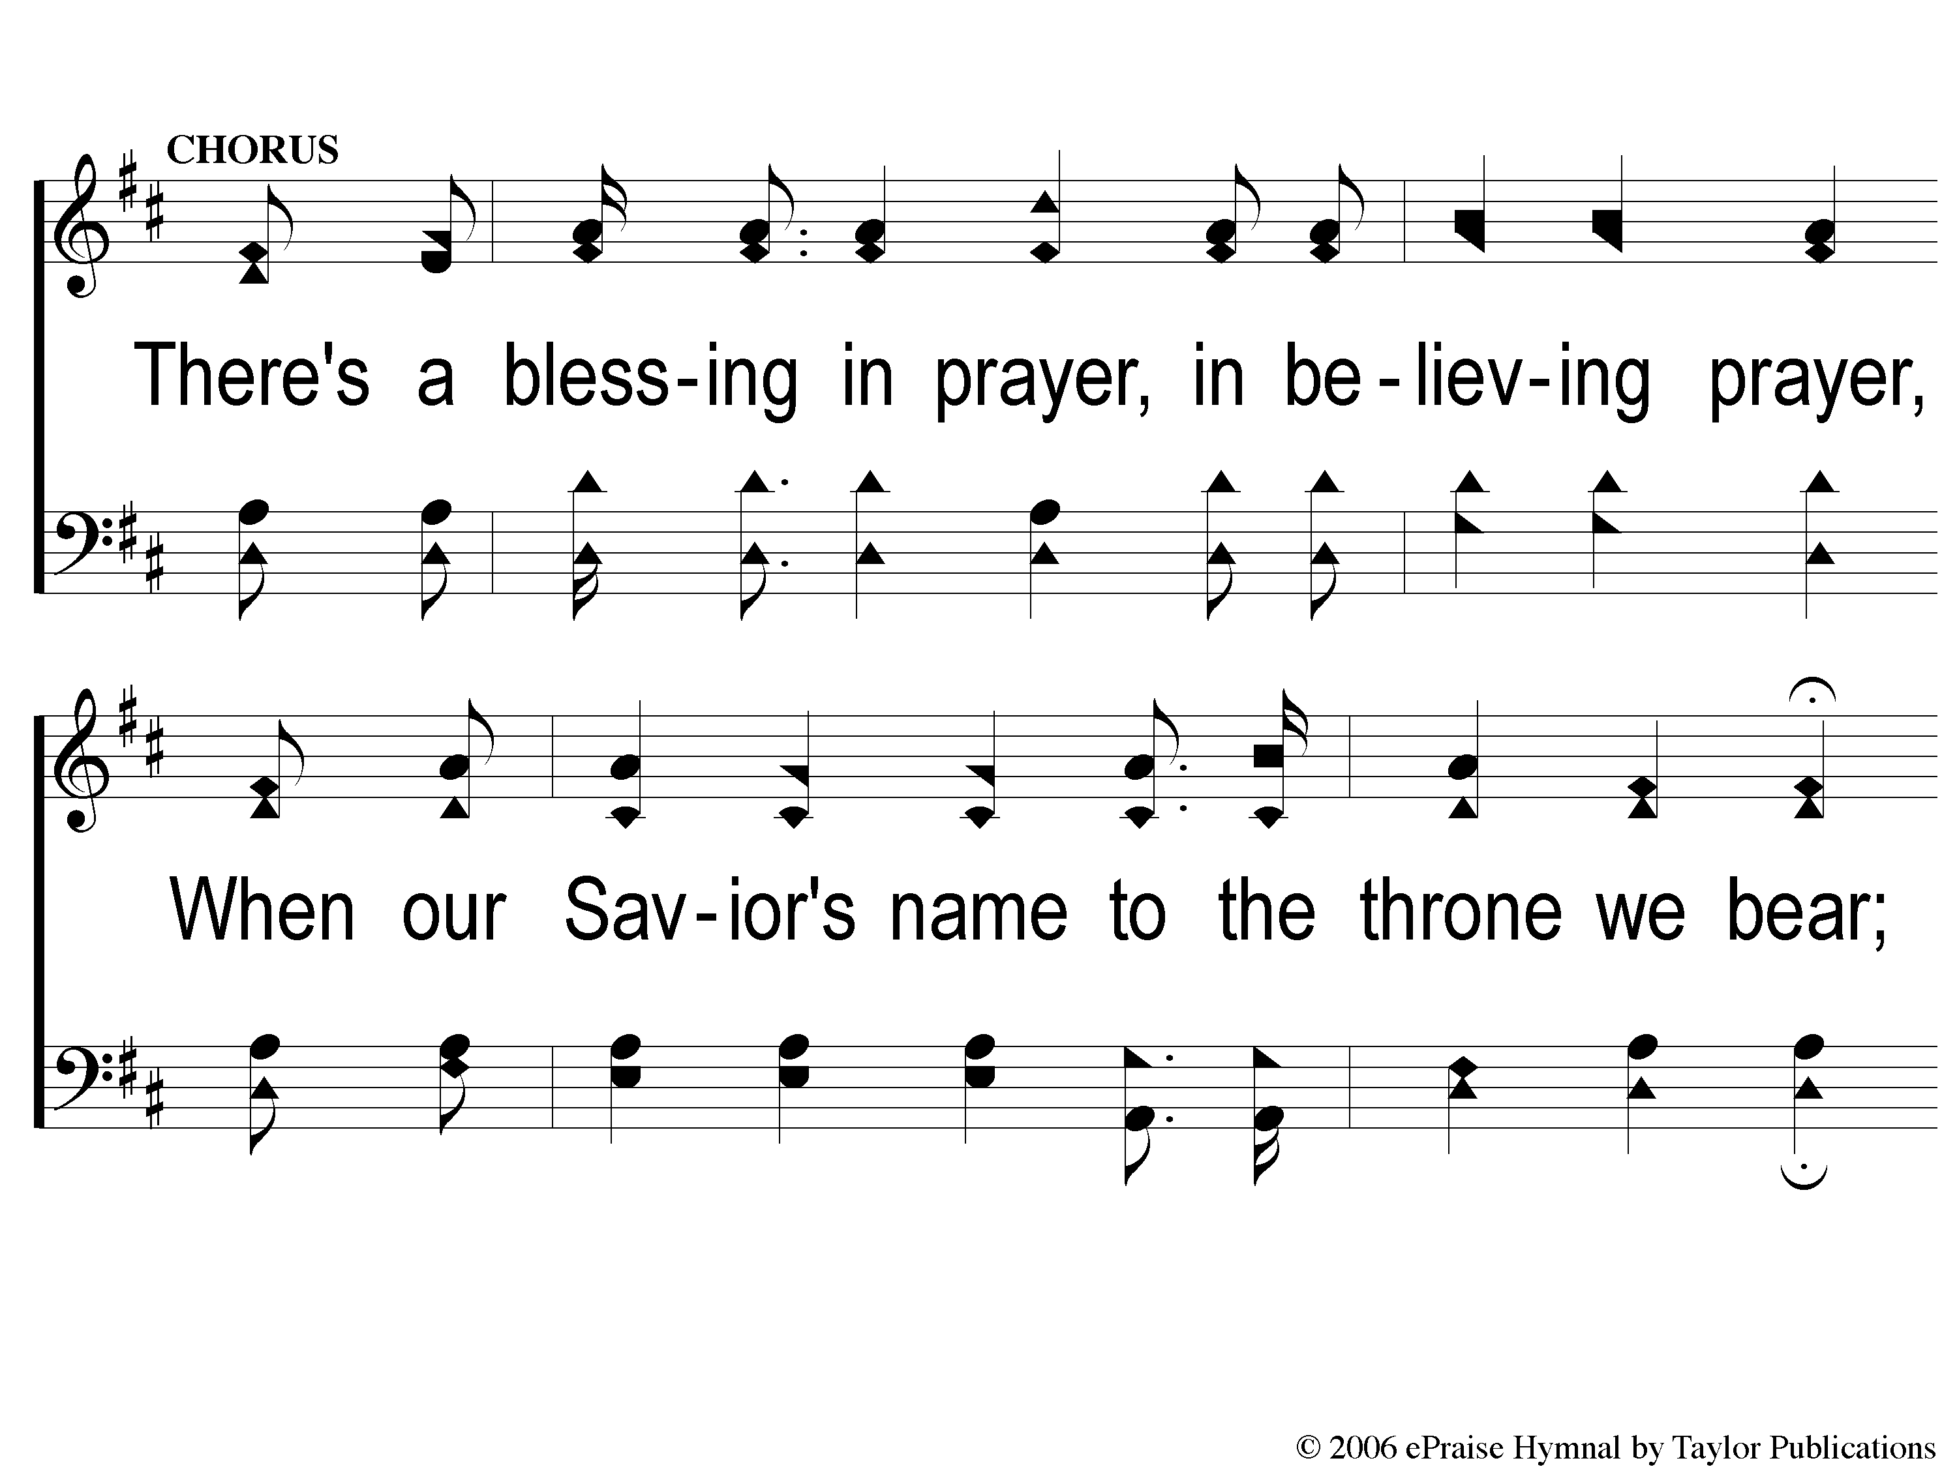
C-1 A Blessing in Prayer
A Blessing In Prayer
13

Slide 4
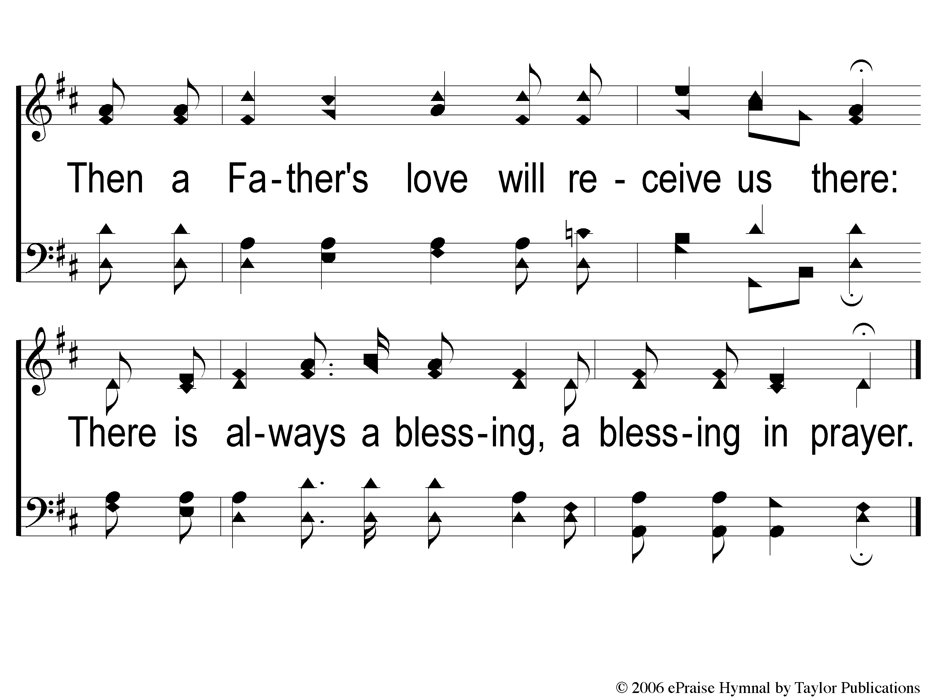
C-2 A Blessing in Prayer
A Blessing In Prayer
13

Slide 5
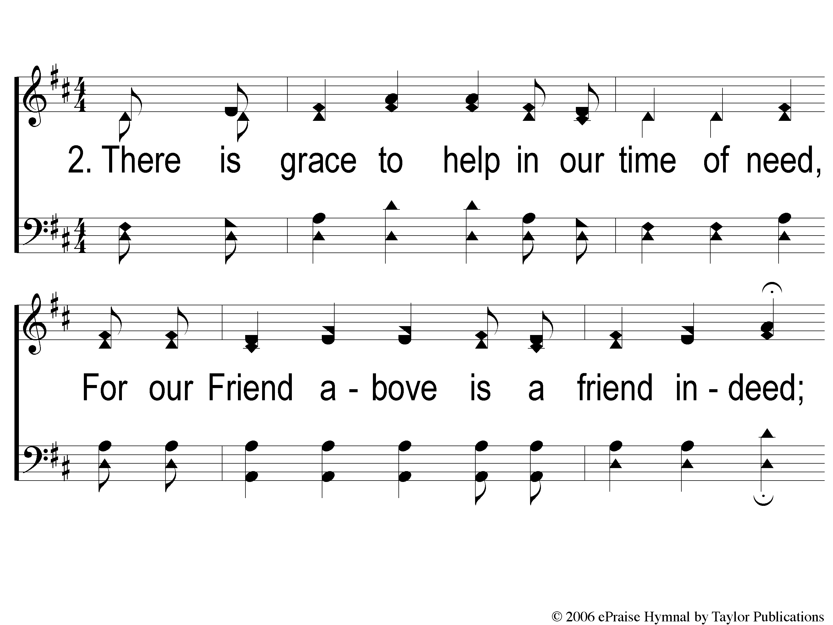
2-1 A Blessing in Prayer
A Blessing In Prayer
13

Slide 6
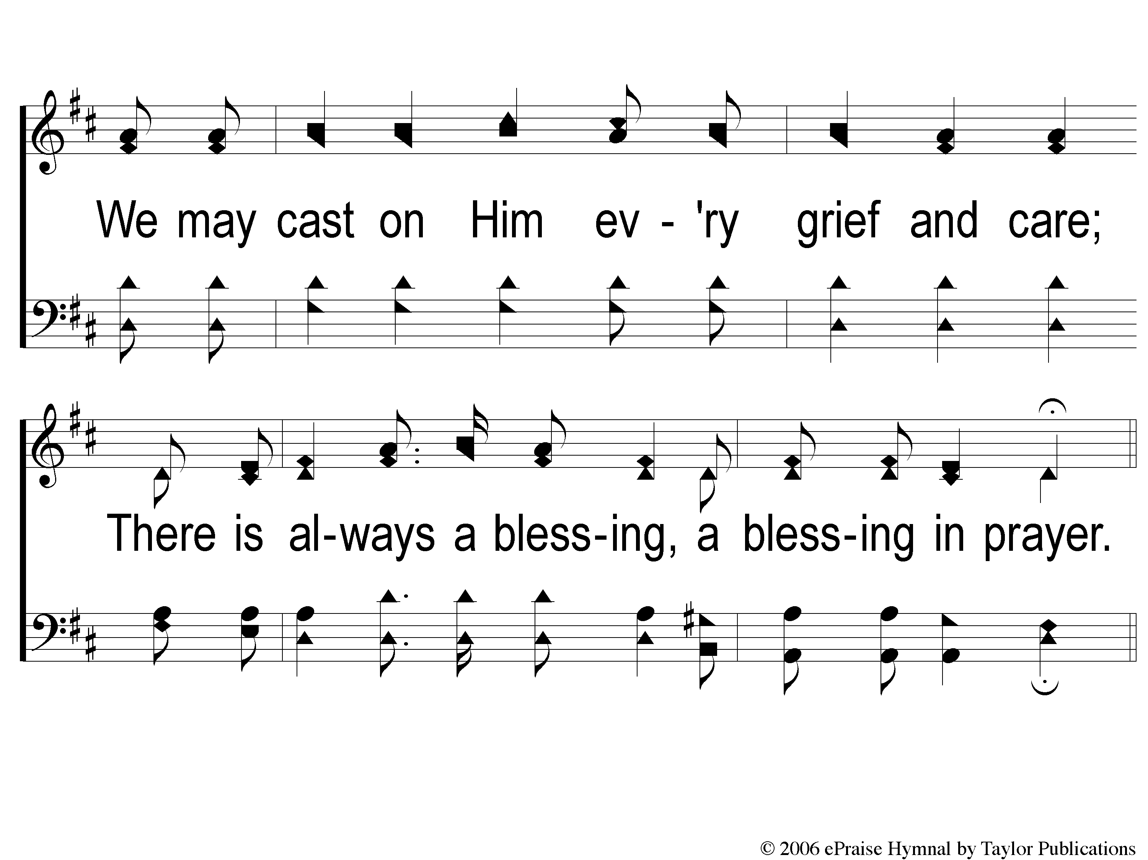
2-2 A Blessing in Prayer
A Blessing In Prayer
13

Slide 7
C-1 A Blessing in Prayer
A Blessing In Prayer
13

Slide 8
C-2 A Blessing in Prayer
A Blessing In Prayer
13

Slide 9
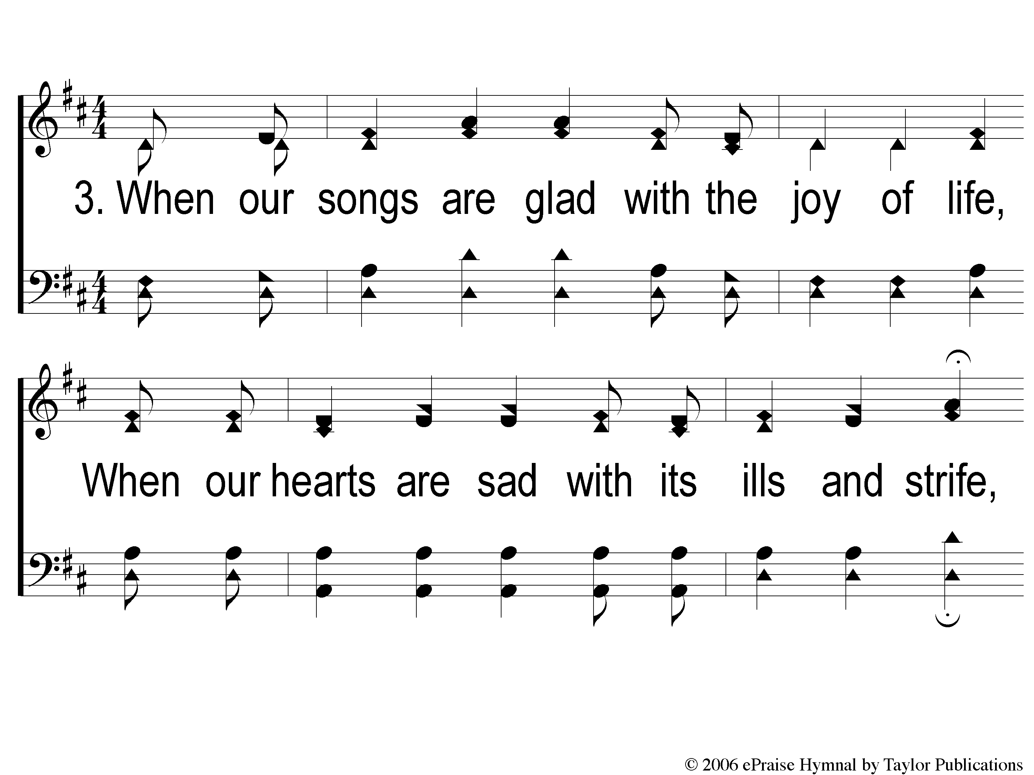
3-1 A Blessing in Prayer
A Blessing In Prayer
13

Slide 10
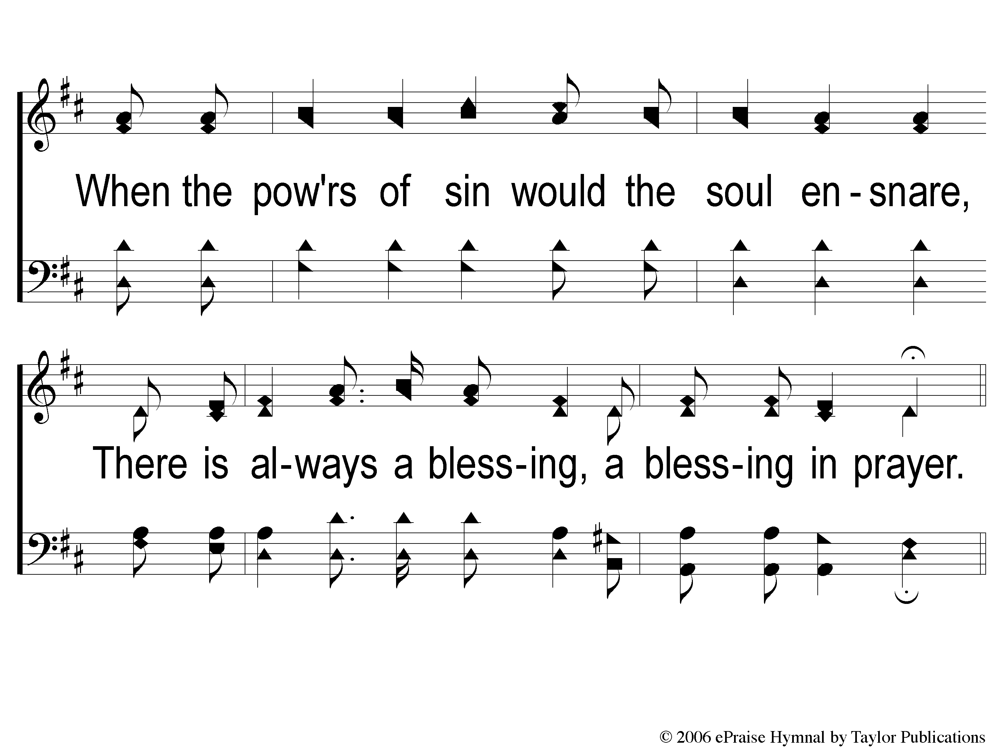
3-2 A Blessing in Prayer
A Blessing In Prayer
13

Slide 11
C-1 A Blessing in Prayer
A Blessing In Prayer
13

Slide 12
C-2 A Blessing in Prayer
A Blessing In Prayer
13

Slide 13
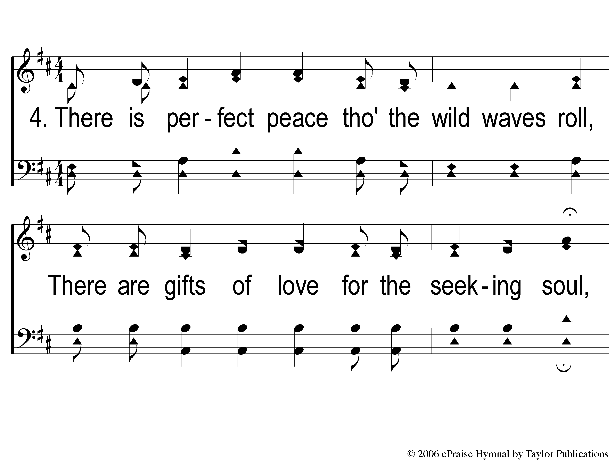
4-1 A Blessing in Prayer
A Blessing In Prayer
13

Slide 14
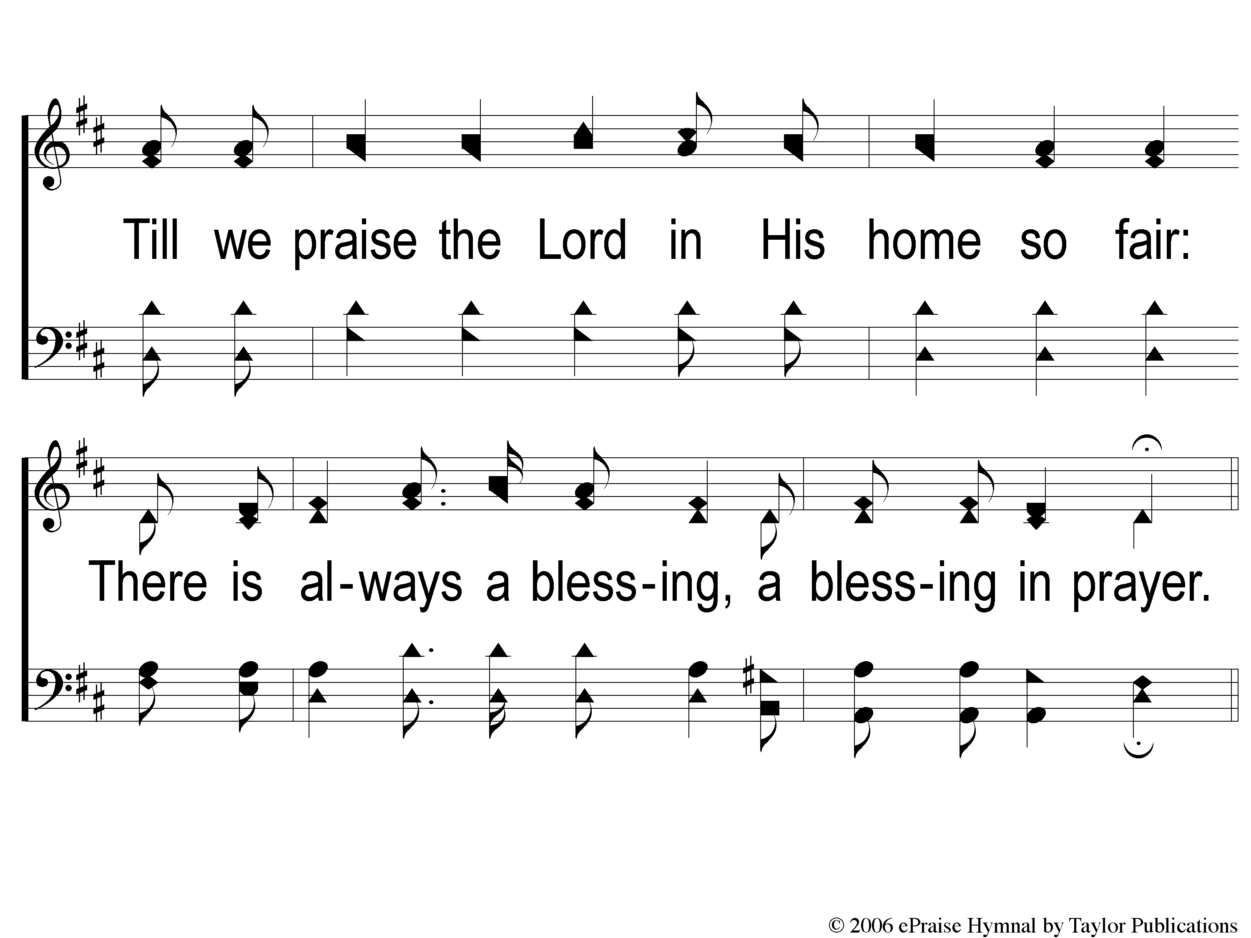
4-2 A Blessing in Prayer
A Blessing In Prayer
13

Slide 15
C-1 A Blessing in Prayer
A Blessing In Prayer
13

Slide 16
C-2 A Blessing in Prayer
A Blessing In Prayer
13

